Slide 1









Collective Impakt
Leadership
The Bigger Picture, Performance, Authentic Voices
Notes:
Neha

Slide 2

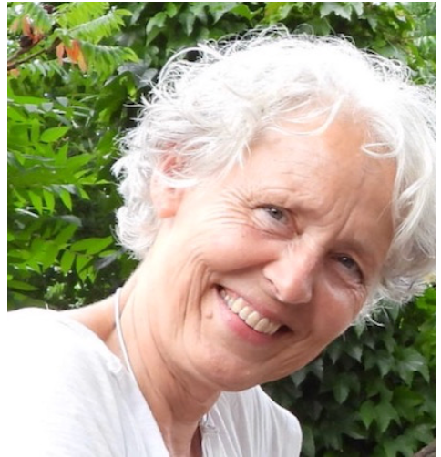
INTRODUCTION
Carin Vijfhuizen
PhD, Development Sociology); Wageningen University, NL; MBA Effective leadership
35 years of expertise in capacity and institutional strengthening in education, organisation and rural development, long term in Africa, Middle East, South-East Asia, Europe.
Leadership roles: Team leader, Principal of international college, Lead monitoring and evaluation
Author of several thematic books, in which leadership is explored.
Entrepreneur: Company Strengthening Leadership in Education and Enterprise
See linked-in profile and my CV on my website www.carinvijfhuizen.com
Notes:
Book Links:
WORTHWHILE could be found on Amazon: https://www.amazon.com/Worthwhile-balancing-treasures-daily-life/dp/3991313405/ref=sr_1_2?crid=PT0A0ICSIWIW&dib=eyJ2IjoiMSJ9.AvlcH5m81m4-gqDUFzRLwJAx0cCLz7SisBoW5axxLus__PgousoRiuvhtFWxjwBdLLrvRjaK4rFbh-gwCdd7Og.8Zk52xWF1-2ClVs5HFxThJzNiiNjjQE7HBfrTQPkJs8&dib_tag=se&keywords=carin+vijfhuizen&qid=1736675749&sprefix=carin+vijfhuizen%2Caps%2C181&sr=8-2
& on BOL.COM : https://www.bol.com/nl/nl/p/worthwhile/9300000129630211/?bltgh=mGQ5T14wYGy8NXEj4DtIRQ.2_6.14.ProductImage
WE WANT TO BE GREAT could be found on Amazon : https://www.amazon.com/We-Want-Great-Carin-Vijfhuizen/dp/1528988418/ref=sr_1_3?crid=PT0A0ICSIWIW&dib=eyJ2IjoiMSJ9.AvlcH5m81m4-gqDUFzRLwJAx0cCLz7SisBoW5axxLus__PgousoRiuvhtFWxjwBdLLrvRjaK4rFbh-gwCdd7Og.8Zk52xWF1-2ClVs5HFxThJzNiiNjjQE7HBfrTQPkJs8&dib_tag=se&keywords=carin+vijfhuizen&qid=1736675749&sprefix=carin+vijfhuizen%2Caps%2C181&sr=8-3
& on BOL.COM : https://www.bol.com/nl/nl/p/we-want-to-be-great/9300000074221496/?bltgh=mGQ5T14wYGy8NXEj4DtIRQ.2_6.16.ProductImage

Slide 3
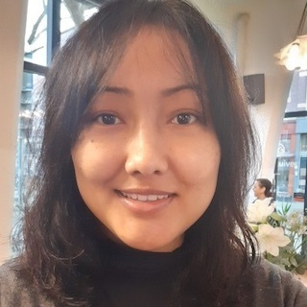
INTRODUCTION
Neha Basnet, PhD.
I am the founder of collective impakt, consultant, Lecturer and researcher.
Board member of ARISA.
Notes:
Neha

Slide 4
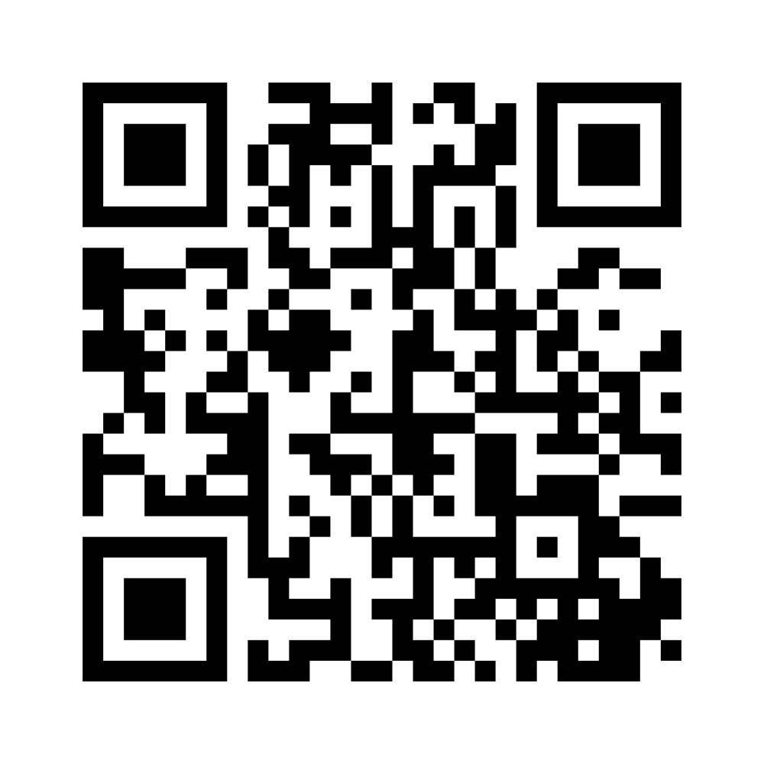
Scan this QR CODE
Notes:
Mentimeter code ---39 02 15 5
Link --- https://www.menti.com/alxy5rfzmdvd

Slide 5

Are you a Leader?
Notes:
1) To make a distinction between personal leadership and leadership of an organisation, company or country. Look at the entity.
2) A leadership’s position will show your leadership qualities through the performance and appreciation of the people you work with.
3) People like to be in charge! Provide them with the steering wheel. Challenge their potential.

Slide 6

What do you expect from leadership?
Notes:
Mentimeter- text
Their expectations about leadership will most likely correlate with the next slide 6: What is leadership about.
Hence the answer on this question in slide 5, will be related to slide 6.

Slide 7

What is Leadership about?
Balancing between leading and following (Worthwhile 2022), hence Flexibility
The bigger picture: Mission, vision.
Core values of an organizational culture, the social glue (We want to be great, 2022, p 93)
The organizational structure. Hierarchical or flat; circular leadership (2022: 176/83-85 WWG)
Recognising authentic voices (competences), thus putting the right people on the right positions: strong teams; making people to lead, feedback & inspiring people.
Performance: motivation X competences X resources (Worthwhile, 2022, p 82)
Psychological contract: recognition & rewards
Integrity: being an example: walk your talk; acting according to what one says
Notes:
Carin

Slide 8

The Advantages of Collective Leadership
Promoting diversity and innovation
Recognising the strengths of an individual within a group
People feel appreciated and rewards
Motivating people
Performance increases
Notes:
Neha

Slide 9




Styles of Leadership
You can find different styles of leadership on the internet
From autocratic to participative, and many in between
The following ingredients contribute to the style::
Ideas, Information, Interaction, (3I)
Control, compliance, compartmentalization (3 C)
Navigating Different Approaches
Notes:
Neha and Carin (Seeing in practice)

Slide 10


Getting Past Obstacles
Strategies
for Success
Passing micro management, creating space for input
Increasing motivation by recognition and rewards
The culture of the bigger picture
01
02
03
Notes:
Mentimeter – What obstacles do you experience in your positions? Neha

Slide 11



Qualities of Successful Leaders
Strengths and Skills
-Performing succesfully according to the mission, vision, goals, core values
-Inspirational, creative and flexible
-Recognise staff’s potential and build strong teams and organisation
-Strengthen capacity: feedback/training
-Provide good working facilities
-Motivate: recognition and rewards
-A clear referencing system (strategy and indicators: what is a good teamleader: We want to be great, 2022: 185
Notes:
Carin

Slide 12


QUALITIES OF A SUCCESSFUL LEADER FOR TOMORROW
Create and focus on a bigger picture.
Strengthen your traits: integrity, openness, positive attitude, pro-active, trust, working together and a learning attitude.
Strengthen motivation (Worthwhile, p 83) through feedback, appreciation; space, trust, recognition and rewards
Space: less hierarchy, no micromanagement; leaders empower others to lead.
Establishing a learning culture (p 92) and a learning policy (p 93) (We want to be great, 2022).
In synergy with the outside world.
From 3 C : Control, Compliance; Compartmentalisation
to 3 I : Ideas; Information, Interaction( p 89, Worthwhile).
Encouraging the Upcoming Generation of Leaders
Notes:
Carin

Slide 13

ANY QUESTIONS?
Encouraging the Upcoming Generation of Leaders
Notes:
Neha

Slide 14




Thank You
www.collectiveimpakt.com
Rotterdam, The Netherlands
0626125998
www.carinvijfhuizen..com
Notes:
Neha

